Slide 1


Transforming Language Resources
Christian Chiarcos
Christian Fäth

Slide 2
Transforming Language Resources
Heterogeneity of Language Resources
The Fintan platform
Design a conversion pipeline
Deploy as a service
Contribute

Slide 3
Heterogeneity of
Language Resources

Slide 4

Varieties of Language Resources
Corpora: TSV/CoNLL, Sketch Engine, Toolbox, TIGER-XML, ... RDF: NIF, Open Annotation, …
Lexical Data: TEI, proprietary XML formats, CSV/TSV, … RDF: OntoLex, …
Terminological Data: Thesauri and Ontologies: SKOS, OWL, … Annotation schemes: GOLD, ISOCat, OLiA, UD, UniMorph, …

Slide 5
Flexible INtegrated Transformation and Annotation eNgineering

Slide 6
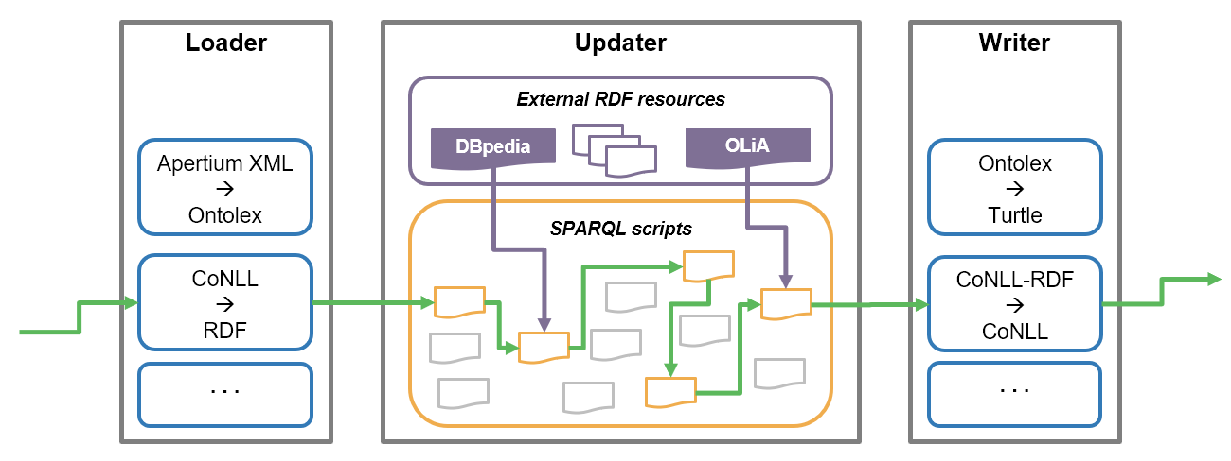
The Concept

Slide 7
Core API
Fintan Core API
Loader
Splitter
Updater
Writer
Transform data to RDF
XML
TSV / CSV
CoNLL
…
Stream RDF data
Split large RDF datasets into digestible segments
Stream RDF segments
Load other resources
Execute SPARQL updates
Parallel processing of RDF segments
Serialize RDF
RDF/XML
Turtle
Json-LD
…
Other output formats
TSV / CSV
CoNLL
…

Slide 8
Architecture
Core Java API with interoperable interfaces
Fintan Core API
Loader
Splitter
Updater
Writer

Slide 9
Architecture
External modules implement the Core API (Maven dependency)
Core Java API with interoperable interfaces
External API modules
tbx2rdf
CoNLL-RDF
Loaders (CoNLL, IOB, XML-TSV, …)
Updater
Formatter
Fintan Core API
Loader
Splitter
Updater
Writer

Slide 10

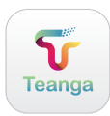
Architecturere
External modules implement the Core API (Maven dependency)
Core Java API with interoperable interfaces
User interface
create and run complex workflows
export dockerized services
compatible to Teanga
External API modules
tbx2rdf
CoNLL-RDF
Loaders (CoNLL, IOB, XML-TSV, …)
Updater
Formatter
Fintan Core API
Loader
Splitter
Updater
Writer
Fintan Service
Integrate modules
Design & Run Workflows
Develop
SPARQL Updates
Fintan UI
External Dockerized Services

Slide 11
How to use Fintan
Java API: Directly use Fintan as a Java application or as an API in your software (CoNLL-RDF, TBX2RDF)
Integrated Workflow Manager: Use Fintan incl. UI as a dockerized service for building and running pipelines
Fintan-SaaS: Deploy Integrated Services to other applications (export Services to Teanga)

Slide 12
Design a pipeline

Slide 13
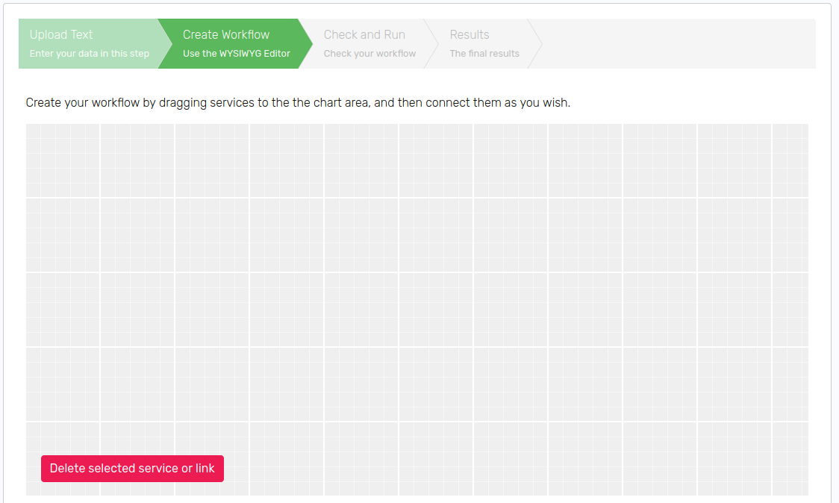
Fintan UI
Input
Apertium to Lexinfo Mapping
SPARQL Update
Uploaded Data
LOAD Resource
LOAD SPARQL
Apertium to RDF
ApertiumXML
OntoLex
SPARQL Query
Update
Annotation
LOAD SPARQL
OntoLex
OntoLex
Export TSV
OntoLex
TSV
Result
Data Result

Slide 14
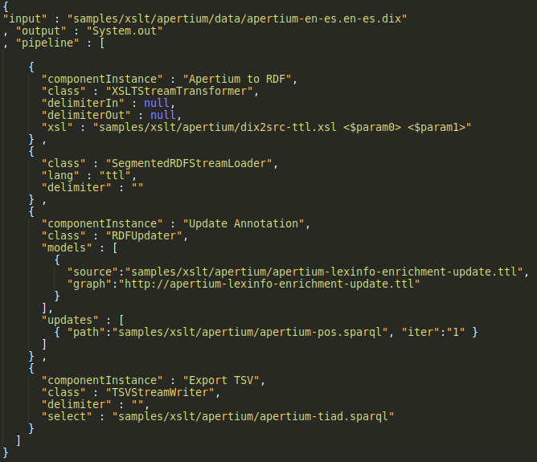
Fintan Configuration
All this translates to a JSON configuration file, which could be run from command-line or exported inside a container.

Slide 15
Fintan Configuration
All this translates to a JSON configuration file, which could be run from command-line or exported inside a container.
First: create Apertium RDF
Apply XSLT transformation
Load the resulting OntoLex entries as segmented RDF-Stream
Apertium to RDF
ApertiumXML
OntoLex

Slide 16
Fintan Configuration
Second: RDF Updater
Load the mapping file
Load the SPARQL update
Apply LexInfo Mapping
Parallel processing per segment
SPARQL Update
LOAD SPARQL
Apertium to Lexinfo Mapping
Update
Annotation
LOAD Resource
OntoLex
OntoLex

Slide 17
Fintan Configuration
Third: Export TIAD TSV
Load SPARQL query
Write TSV data
SPARQL Query
Export TSV
LOAD SPARQL
OntoLex
TSV

Slide 18
Fintan Configuration
Apertium to RDF
ApertiumXML
OntoLex
SPARQL Update
LOAD SPARQL
Apertium to Lexinfo Mapping
Update
Annotation
LOAD Resource
OntoLex
OntoLex
SPARQL Query
Export TSV
LOAD SPARQL
OntoLex
TSV

Slide 19
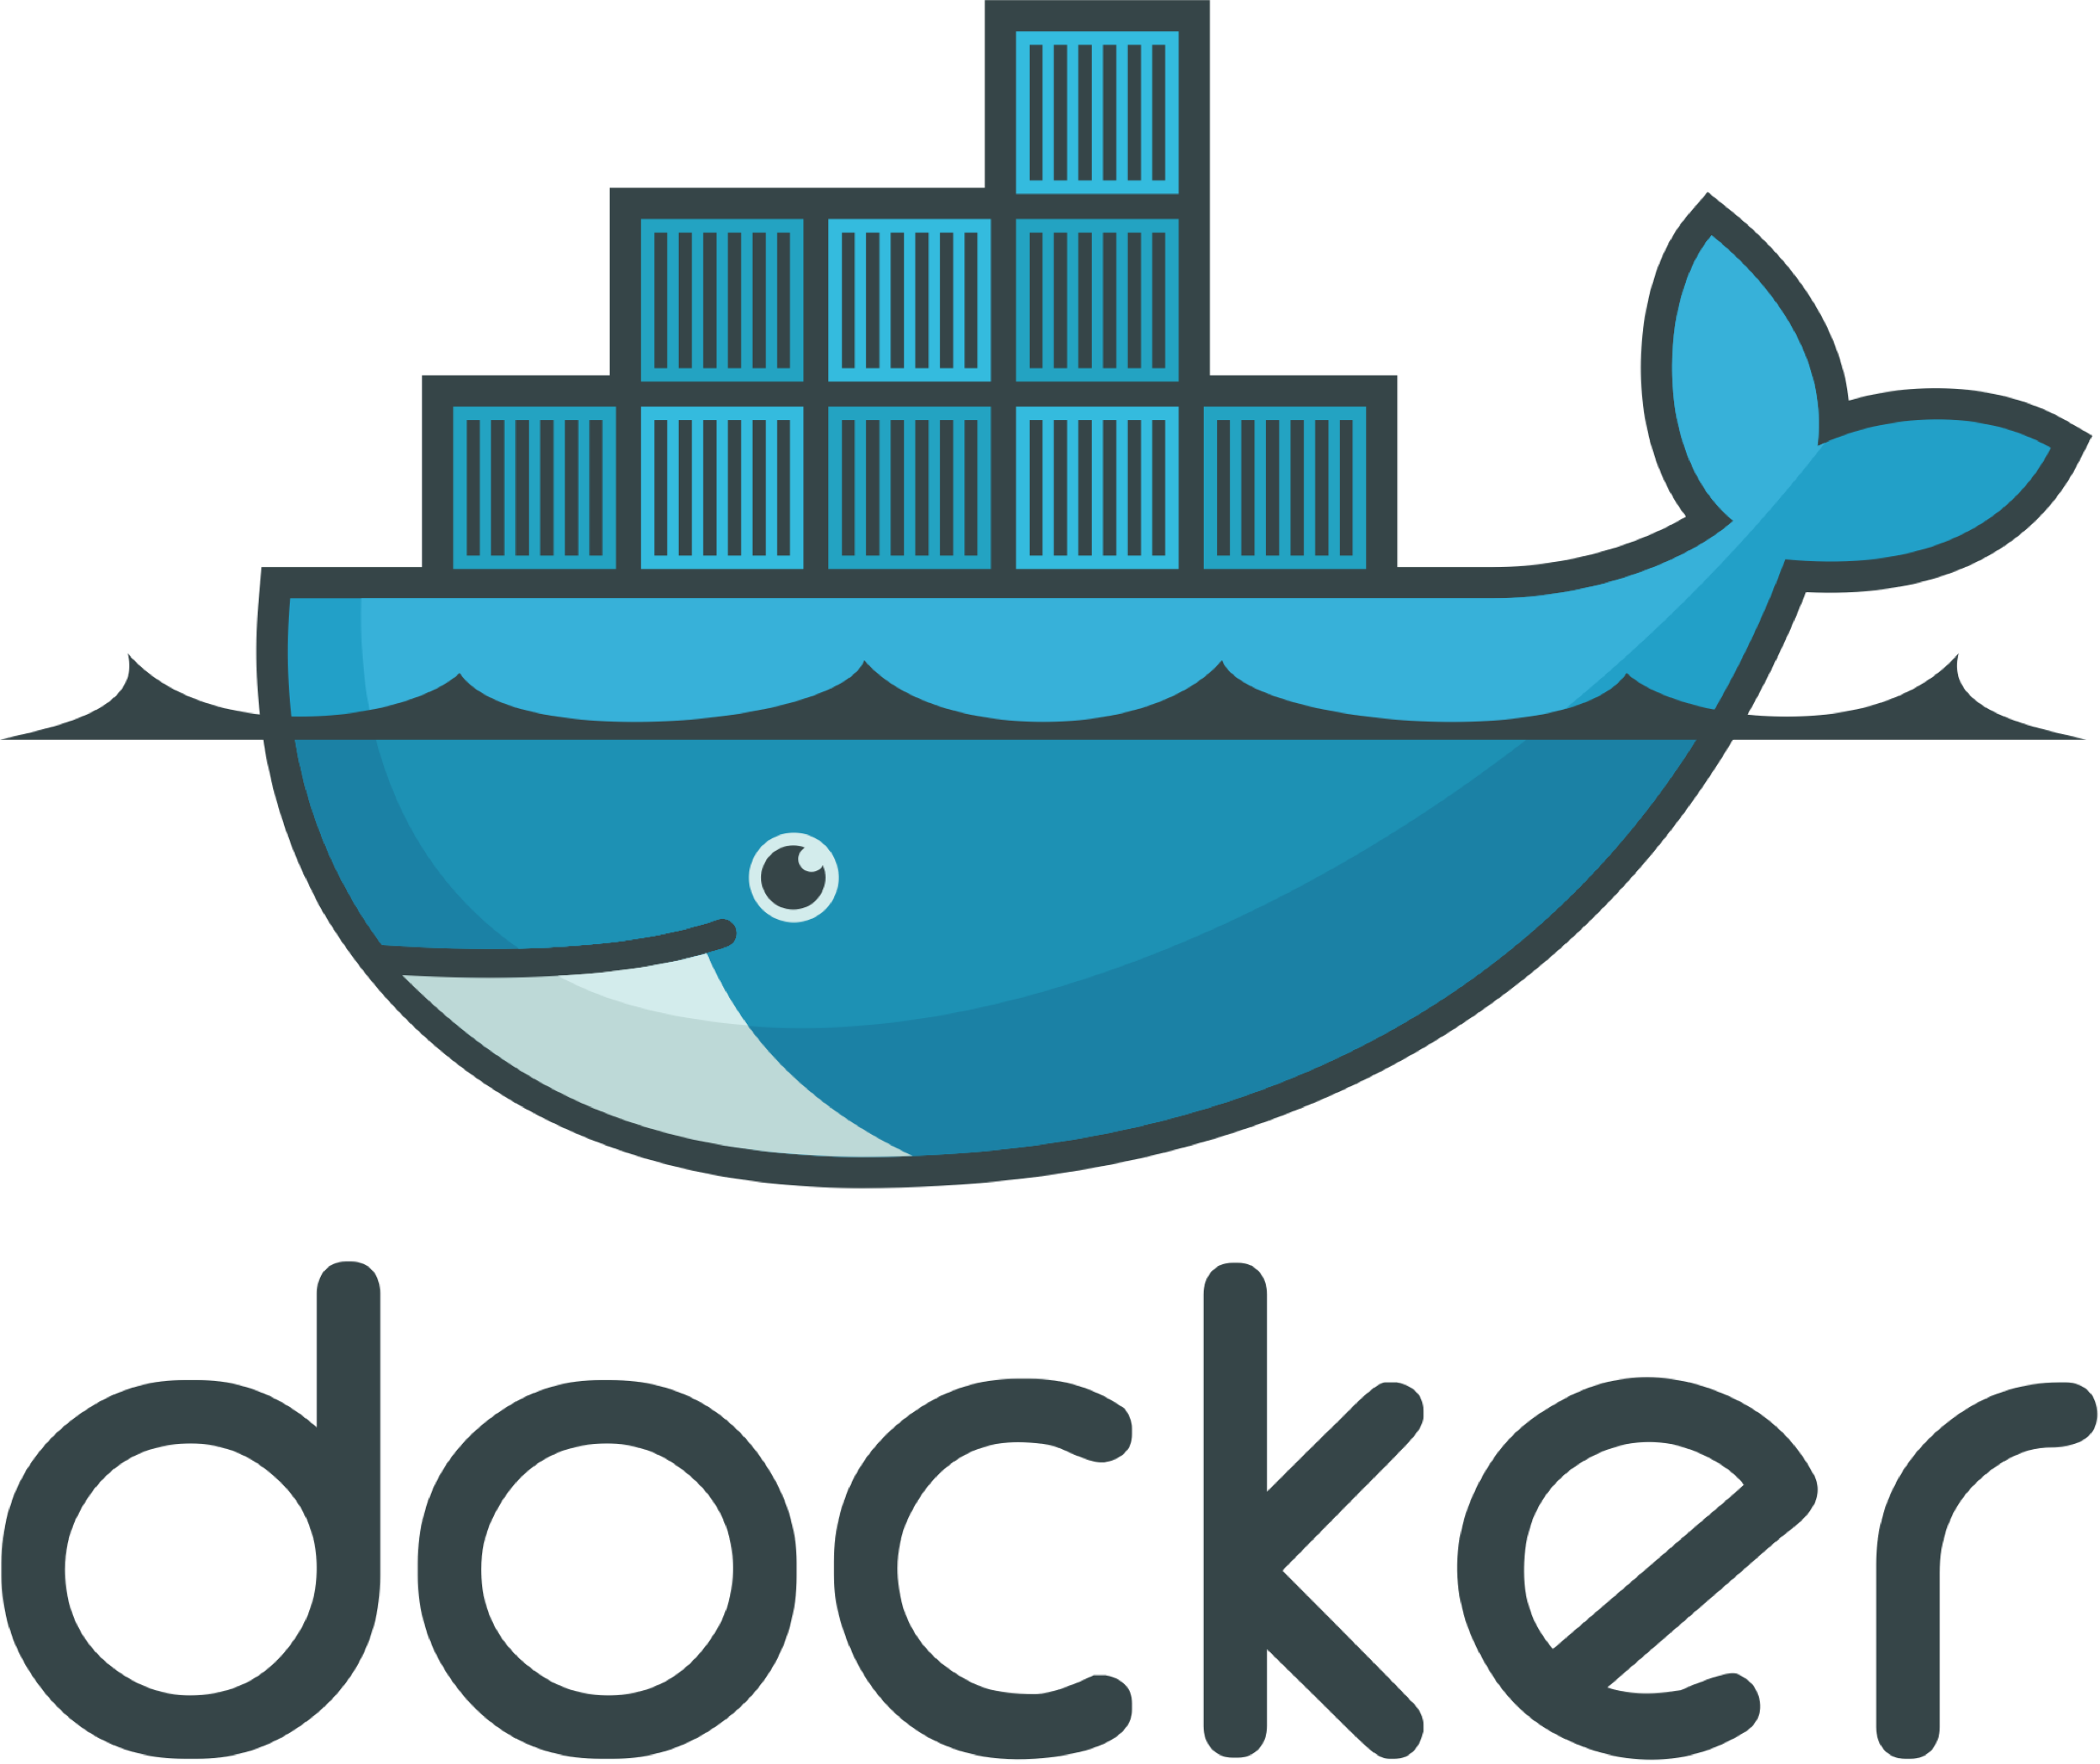
meets
Deploy as a service

Slide 20
Fintan pipeline as a Docker container
Preconfigured pipeline
Contains everything required to run Fintan for a specific task
Exposes rudimentary API to provide the input and collect the output
Plain text
Gzipped text
JSON
Can be called from Teanga, curl, Swagger UI (included)
docker build --tag fintan-api .
docker run -d -p 8080:8080 --name fintan-api

Slide 21
Contribute

Slide 22
How to contribute
Fintan is an extensive converter suite
Add Fintan to your projects: Simply define the Maven dependency
Directly benefit:
Fomalized pipeline development
Parallel streamed graph processing
Preconfigured converter pipelines and components
Fintan is an extensible converter suite
Implement the Core API
Use your tools directly in the workflow manager
Deploy to central Fintan repository
Gain visibility for your own converters
What’s next?
Fintan will be published as a software deliverable of the Prêt-à-LLOD project on Sep. 30
We will actively work on adding more components and preconfigured pipelines.

Slide 23
Get in touch! https://github.com/pret-a-LLOD/Fintan https://github.com/acoli-repo/conll faeth@em.uni-frankfurt.de chiarcos@cs.uni-frankfurt.de Thank you!

Slide 24
Fintan pipeline as a Docker container
Preconfigured pipeline
Contains everything required to run Fintan for a specific task
No Fintan UI included — UI generates Dockerfile, not vice versa
Exposes rudimentary API to provide the input and collect the output
Plain text
Gzipped text
JSON
Can be called from Teanga, curl, Swagger UI (included)
OpenAPI specification
Should be easily integrated in Teanga: testing needed
For now, I/O specification is basic: 1 input (+ optionally additional data supplied), 1 output
No workflow building UI in the container, why?
The service is build to be non-interactive, adapted to Teanga filosophy
A pipeline must be created beforehand, as a previous step
Executing pipelines in the UI will be added next, as an alternative to downloading Dockerfile+JSON

Slide 25
Fintan pipeline as a Docker container: Technical details
Multi-stage build
Container size minimized → 326 MB
Last stage runs as a non-root user
On the last build stage (what goes into the container) — only runtime components:
Compiled Fintan + JRE
Flask-based API running via gunicorn
Swagger UI
A JSON Fintan pipeline and all the necessary data
Undocumented functions
API provides endpoints to upload additional pipelines and data files
Technically, every generated container can run any pipeline given that the pipeline and necessary data is uploaded
What’s next?
Consolidation of Teanga UI and Fintan UI
Asynchronous pipeline execution in the UI (→ extending API for using a task queue)

Slide 26
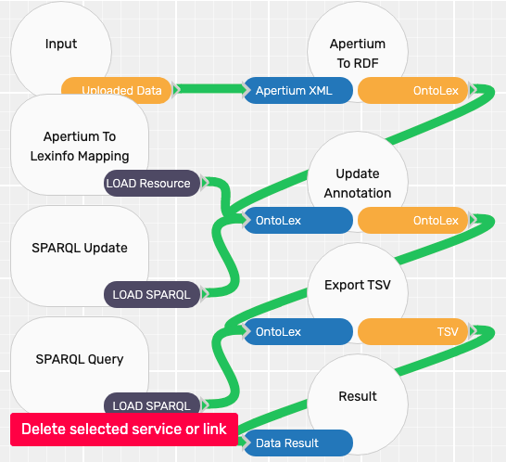
Fintan UI
UI comprised of
elements of Fintan Core API (Read/Write/Update)
combined with external resources
All of this could be organized into a conversion pipeline

Slide 27
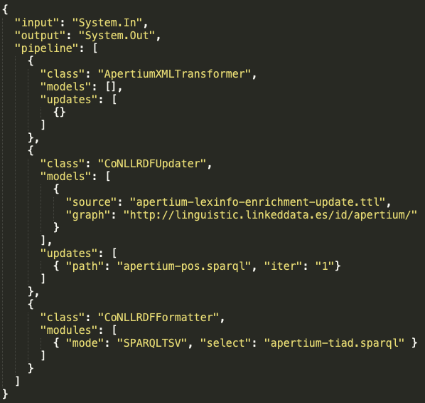
Fintan Configuration
Internally, the pipeline is a JSON object
with a list of steps
and information about resources
This JSON file was returned to a user who could use Fintan to run it

Slide 28
Fintan UI and configuration

Slide 29
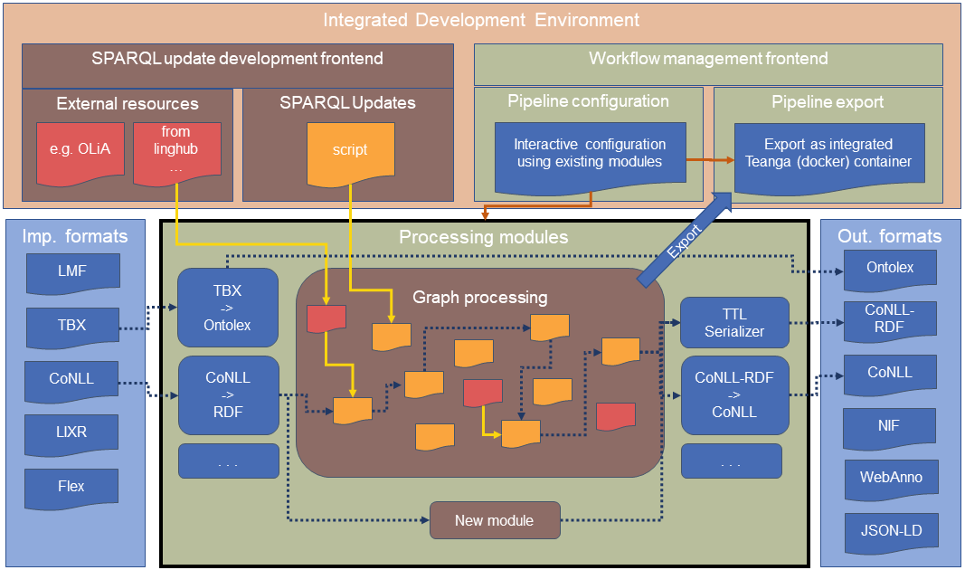
Platform

Slide 30
Platform
common interface
interoperable conversion steps
through graph transformation
existing converters
existing converters

Slide 31
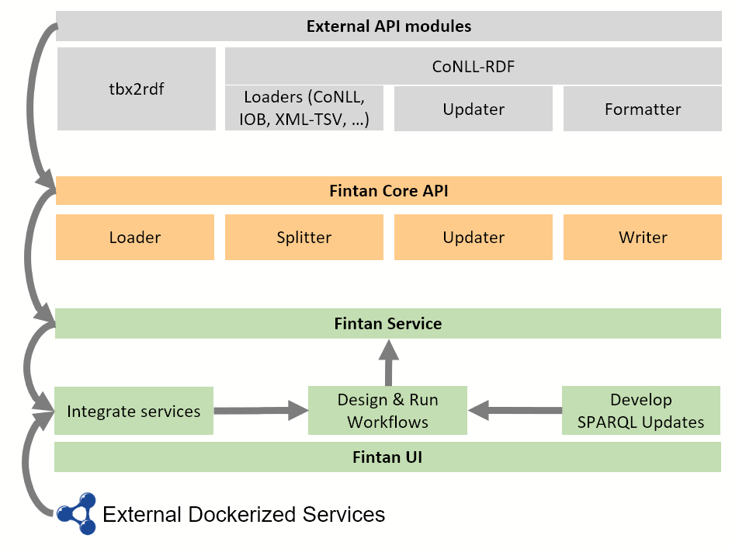
Architecture
Direct imports for Java programs implementing the Core API (Maven)
Core API with basic interfaces ensuring interoperability
Service architecture to manage and run pipelines
User interface
including of dockerized services (for non-native applications/converters)

Slide 32
Architecture
Direct imports for Java programs implementing the Core API (Maven)
Core API with basic interfaces ensuring interoperability
Service architecture to manage and run pipelines
User interface
including of dockerized services (for non-native applications/converters)

Slide 33
Progress on the backend
extensive refactoring of CoNLL-RDF
Maven support
Homogeneous CLI
Standard test cases
now accommodates for Fintan Core API (WIP)
backward compatibility with existing pipelines
still usable as stand-alone

Slide 34
Progress on the backend
progress on Core API
now supports multiple I/O Streams for independent preprocessing of data segments
Splitter consolidated (Loaders and Updates may directly split data into segments)
RDF-Datastreams objectified (for decreased overhead)
open
optimize configuration scheme to accommodate the changes
thorough testing and consolidation with CoNLL-RDF
adjust tbx2rdf wrapper

Slide 35
Architecture
Direct imports for Java programs implementing the Core API (Maven)
Core API with basic interfaces ensuring interoperability
Service architecture to manage and run pipelines
User interface
including of dockerized services (for non-native applications/converters)

Slide 36
Towards a deliverable

Slide 37
Software deliverable
On GitHub https://github.com/Pret-a-LLOD/Fintan
Fintan developed at GUF, contributions from all
Sub-modules to be upgraded to proper code integration
Backend operational
applicability demonstrated in collaboration with UZAR and SEM
Frontend under development
prototypes for workflow management and SPARQL editing
H1/2021 focus on service architecture
interface specifications planned March (Docker/OpenAPI)
joint work with NUIG and UNIBI
H2/2021 focus on usability and consolidation
frontend: integrating Teanga UI and Fintan UI codebases
integrate T3.1 partner contributions (all partners)

Slide 38
Published Resources

Slide 39
(Some) Newly published resources
DimLex: Discourse markers inventories
Discourse marker inventories for 20 languages
OntoLex resource
Linked to OLiA and Penn Discourse Treebank
APiCS-Ligt: Example sentences in creole and pidgin languages
Sentences in 76 low-resource languages with morphological segmentation and annotation
Ligt resource
Linked to OLiA and MMoOn categories
Both to be presented @ LDK
Any other resources?

